Slide 1
Chemistry 3A
Introductory General Chemistry
Math of Chemistry: Scientific Notation, Significant Digits/Figures, Conversions, Density, Temperature Scales
S. M. Halloran

Slide 2
Math in review
(Measured) Quantities
Scientific Notation / Standard Notation
Precision: Significant Digits (Significant Figures)
Decimal Places
Operations on Numbers (multiplication/division, addition/subtraction) & How Precision Affected
Conversions / Dimensional Analysis
Density
Temperature: Scales, Conversion

Slide 3
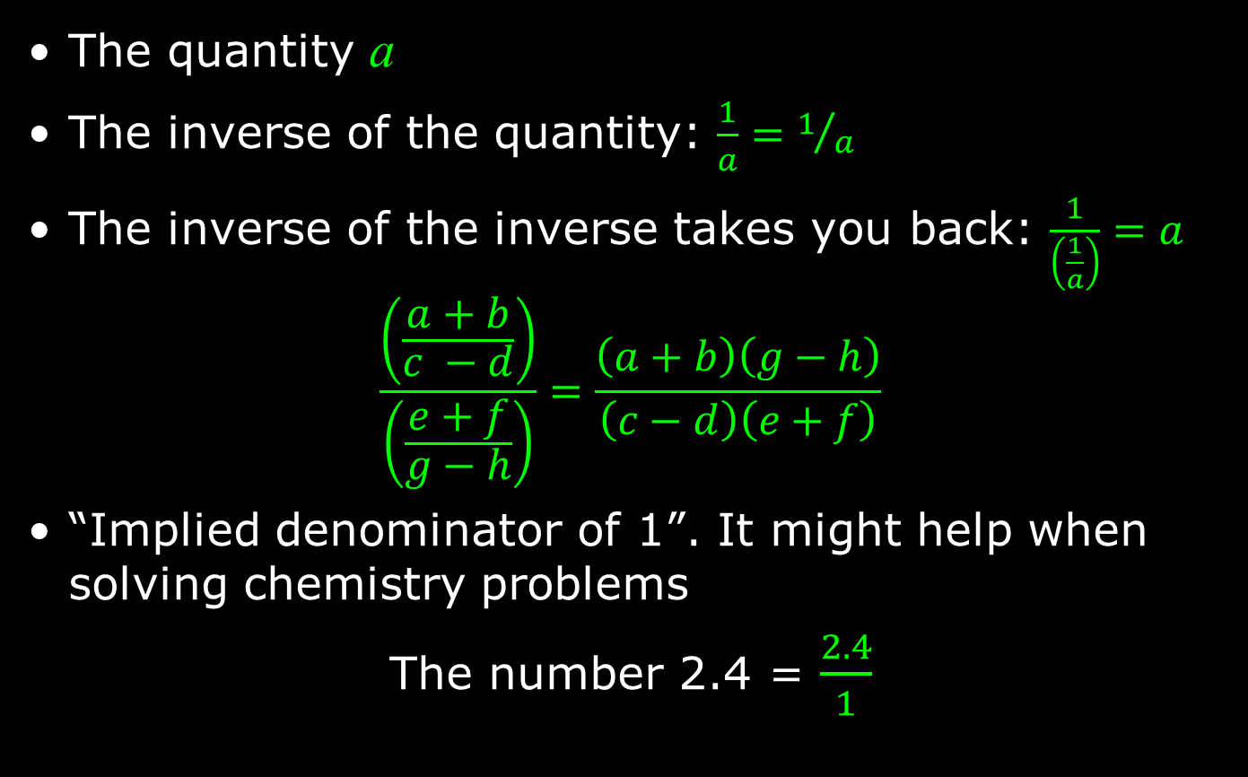
Math in Chem: Algebra Review
The quantity a
The inverse of the quantity: $\frac{1}{a}=1/a$
The inverse of the inverse takes you back: $\frac{1}{\left(\frac{1}{a}\right)}=a$
$$\frac{\left(\frac{a+b}{c −d}\right)}{\left(\frac{e+f}{g−h}\right)}=\frac{\left(a+b\right)\left(g−h\right)}{\left(c−d\right)\left(e+f\right)}$$
“Implied denominator of 1”. It might help when solving chemistry problems
The number 2.4 = $\frac{2.4}{1}$

Slide 4
Quantities
Number | Unit | Dimension
1 | mile | length (distance)
0.25 | liters | volume
15 | amperes | electric current
A (measured) quantity in science, in chemistry has a number and a unit associated with it
The number is how many/much
The unit is a scale of the measurement, the how many/much of what

Slide 5
Scientific Notation
A way of expressing numerical values
Format: d.mmm × 10^{n}
Part | d.mmm
Part Name | Significand (preferred), Coefficient, (Mantissa is obsolete term)
Part Property | Number greater than or equal to 1.0 and less than 10. This number properly express significant digits
Part | 10^{n}
Part Name | Exponent
Part Property | Exponent of 10 where n is integer, negative, positive (note 10⁰ = 1)

Slide 6

Scientific Notation
decimal point moves to right
1. = 10⁰
10. = 10¹
100. = 10²
decimal point moves to left
0.1 = 10⁻¹ = 1/10 = $\frac{1}{10}$ (expressed in various ways)
0.01 = 10⁻² = 1/100 = $\frac{1}{100}$
0.001 = 10⁻³ = 1/1000 = $\frac{1}{1000}$
1 atmosphere (atm) = 101,325 Pascals (Pa)

Slide 7
Scientific Notation
Is the number less than 10 and greater than 1?
  You don’t really need scientific notation, because it will be
  [ d.mmm × 10⁰ ] and 10⁰ = 1, so → d.mmm
Otherwise take the number and express as d.mmm
If original number is greater than d.mmm
you have to multiply by 10¹ n times to get to original number, so n will be positive (greater than zero): n × 1 = n (greater than zero)
If original number less than d.mmm
you have to multiply by 10⁻¹ n times to get to original number, so n will be negative (greater than zero): n × -1 = -n (less than zero)

Slide 8
Scientific Notation
Reiterating #3
If original number is greater than d.mmm
you have to multiply by 10¹ n times to get to original number, so n will be positive (greater than zero): n × 1 = +n
Your book: “if you moved decimal point to the left n places, then n is positive”
35 → 35. → 3.5 moved to left 1 place
3.5 × 10¹
23849 → 23849. → 2.3849 moved to left 4 places
2.3849 × 10⁴

Slide 9
Scientific Notation
Reiterating #4
If original number less than d.mmm
you have to multiply by 10⁻¹ (or divide by 10) n times to get to original number, so n will be negative (less than zero): n × -1 = -n
Your book: “if you moved decimal point to the right n places, then n is negative”
0.0000035 → 3.5 moved to right 6 places
3.5 × 10⁻⁶
0.023849 → 2.3849 moved to right 2 places
2.3849 × 10⁻²

Slide 10
Scientific Notation
Patterns for memorizing
decimal point movement – number being changed – final exponent value
Left – Large – Positive
Right – Small – Negative
Positive and negative for exponent, not significand!
34249 → 3.4249 × 10⁴
-34249 → -3.4249 × 10⁴
0.0034249 → 3.4249 × 10⁻³
-0.0034249 → -3.4249 × 10⁻³

Slide 11
Verifying Your Scientific Notation
Scientific notation is actually a product of two numbers: the significand and a power of 10!
34249 = 3.4249 × 10⁴ = 3.4249 × 10,000 = 34249
-34249 = -3.4249 × 10⁴ = -3.4249 × 10,000 = -34249
0.0034249 = 3.4249 × 10⁻³ = 3.4249 × 0.001 = 0.0034249
-0.0034249 = -3.4249 × 10⁻³ = -3.4249 × 0.001 = -0.0034249
Use this feature to confirm whether you converted a number to scientific notation properly!
If the calculator persists with scientific notation, look for a function button that switches back to standard notation

Slide 12
Practicing Scientific Notation
Let’s start with an “original” number
  one not in scientific notation
  This number will be (much) greater than 10
238,700
Two hundred thirty-eight thousand seven hundred

Slide 13
Practicing Scientific Notation
238,700
Our goal will be to get to a number between 1 and 10 since scientific notation requires it, and it should include the leftmost non-zero digit to the rightmost non-zero digit
This span of digits will be the significand
The significand should in the end be of
d.mmm… form2.387
So we need to determine the exponent (power of 10)

Slide 14
Practicing Scientific Notation
1. Place the “implied” decimal point where it should be
238,700.
2. Move it in the direction of where it should end up
  This is to the left to produce a 2.387 significand
23,870.
3. What is the relationship between 238,700 and 23,870? You have to multiply by 10!
That is 238,700 = 23,870 x 10
We also note that 10 = 10¹
So 238,700 = 23,870 x 10¹
Let’s repeat the movement until we get to proper form

Slide 15
Practicing Scientific Notation
238,700. (the original number)
23,870. → 23,870 x 10¹ = 238,700
2,387. → 2,387 x 10² = 238,700
238.7 → 238.7 x 10³ = 238,700
  Note that we were dropping zeroes until we hit the non-zero number “7”, but the decimal point still moves
23.87 → 23.87 x 10⁴ = 238,700
2.387 → 2.387 x 10⁵ = 238,700
  The decimal point was not moved to create the significand: we have a number less than 10, greater than 1. With each movement of decimal point, we created the power of 10. At every step, equal to original number

Slide 16
Practicing Scientific Notation
Let’s try a number much less than 1
0.00003049 (the original number)
Following the rules/format, the significand should look like 3.049 in the end
0.0003049 / 10 = 0.00003049
  0.0003049 x 10⁻¹ = 0.00003049
0.003049 / 100 = 0.00003049
  0.003049 x 10⁻² = 0.00003049
0.03049 / 1000 = 0.00003049
  0.03049 x 10⁻³ = 0.00003049
0.3049 / 10000 = 0.00003049
  0.3049 x 10⁻⁴ = 0.00003049
3.049 / 100000 = 0.00003049
  3.049 x 10⁻⁵ = 0.00003049

Slide 17
Significant Digits
Significant digits indicate the precision, the confidence of a single measurement
Also called significant figures
Measurement/Value | Significant Digits | Explanation
1.7 | 2 | All non-zero digits significant
1.732 | 4
17.32704 | 7 | Zeroes between non-zero digits are significant

Slide 18
Significant Digits
Measurement/Value | Significant Digits | Explanation
0.0045 | 2 | leading zeroes after decimal point not significant
0.00450 | 3 | trailing zeroes after decimal are significant
1200 | 2
1200. | 4 | assertion of decimal point makes significant
0.000 | 0 | no non-zero digits at all
1000.0 | 5 | adding decimal point and any zeroes after it makes all digits significant
100 | 1 | evaluated like the “1200” example above
1.200 × 10⁻³ | 4 | all digits in scientific notation should be significant

Slide 19
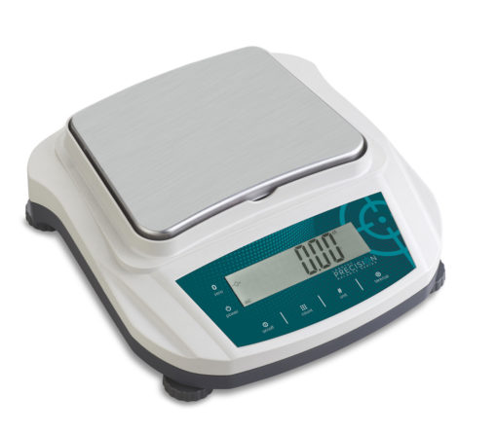
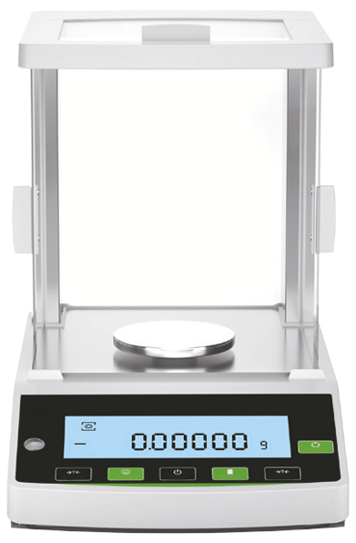
Significant Digits
Significant digits indicate the precision, the confidence of a single measurement
Preparative balance
Measuring quantities usually 0.1 g (100 mg) or greater
used to weigh masses for starting a chemistry experiment
Precision example: 3.4 g sodium chloride (NaCl)
Analytical balance
Measuring quantities usually down to 0.0001 g (0.1 mg or 100 µg) or greater
used to weigh masses for determining yield of product at end of a chemistry experiment
Precision example: 0.0241 g copper(II) sulfate pentahydrate

Slide 20
18 ≠ 18. ≠ 18.0 ≠ 18.00
They are all mathematically equal to 18
But they are not the same in terms of the precision or certainty of the value
18 ➔ 2 significant digits: ±1
18. ➔ also 2 significant digits: ±1
  But the measuring device will show decimals
18.0 ➔ 3 significant digits: ±0.1
18.00 ➔ 4 significant digits: ±0.01

Slide 21
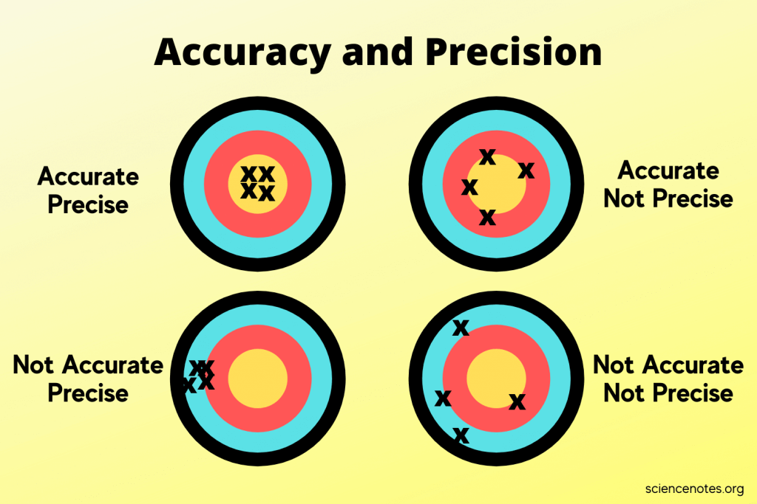
A Slight Tangent on “Precision”
Multiple Measurements
Precision – an indicator of how measurements repeat the value being measured
Accuracy – an indicator of how measurements get to the true value

Slide 22
Significant Digits in Scientific Notation
The rules on significant digits in numerical values always apply in scientific notation
2.69 × 10⁻⁵ = 0.0000269 (3 significant digits)
2.69000 × 10⁻⁵ = 0.0000269000 (6 significant digits)
2.69 × 10³ = 2690 (3 significant digits)
You still have add the zero to get standard form of number as integer
2.69000 × 10³ = 2690.00 (6 significant digits)

Slide 23
Doing Math with “Decimal Places”
Addition and Subtraction of Numbers with Different Decimal Places
Decimal places for final answer should be the one number with the fewest number of decimal places
Solve 12.11 + 18.0 + 1.013 =
Solve 100.29 – 2.343 – 72.9 =
Solve 1000.23 – 87.532 + 200.49 – 50.439 =
 |  |  |  | Result
 |  |  |  | Calculator's Display | Your Answer
Value | 12.11 | 18.0 | 1.013 | 31.123 | 31.1
Decimal Places | 2 | 1 | 3 | 3 | 1
 |  |  |  | Result
 |  |  |  | Calculator's Display | Your Answer
Value | 100.29 | 2.343 | 72.9 | 25.047 | 25.0
Decimal Places | 2 | 3 | 1 | 3 | 1
 |  |  |  |  | Result
 |  |  |  |  | Calculator's Display | Your Answer
Value | 1000.23 | 87.532 | 200.49 | 50.439 | 1062.749 | 1062.75
Decimal Places | 2 | 3 | 2 | 3 | 3 | 2

Slide 24
Doing Math with Sig Digits
Multiplication and Division of Numbers with Different Significant Digits
Significant digits for final answer should be the one number with the fewest number of significant digits
Solve 4.56 x 1.4 =
Solve 834.4 ÷ 34.92 x 2.104 =
Solve 2340.09 ÷ 24.190 =
 |  |  | Result
 |  |  | Calculator's Display | Your Answer
Value | 4.56 | 1.4 | 6.384 | 6.4
Sig Digits | 3 | 2 | - | 2
 |  |  |  | Result
 |  |  |  | Calculator's Display | Your Answer
Value | 834.4 | 34.92 | 2.104 | 50.27427262 | 50.27
Sig Digits | 4 | 4 | 4 | - | 4
 |  |  | Result
 |  |  | Calculator's Display | Your Answer
Value | 2340.09 | 24.190 | 96.7379082265 | 96.738
Sig Digits | 6 | 5 | - | 5

Slide 25
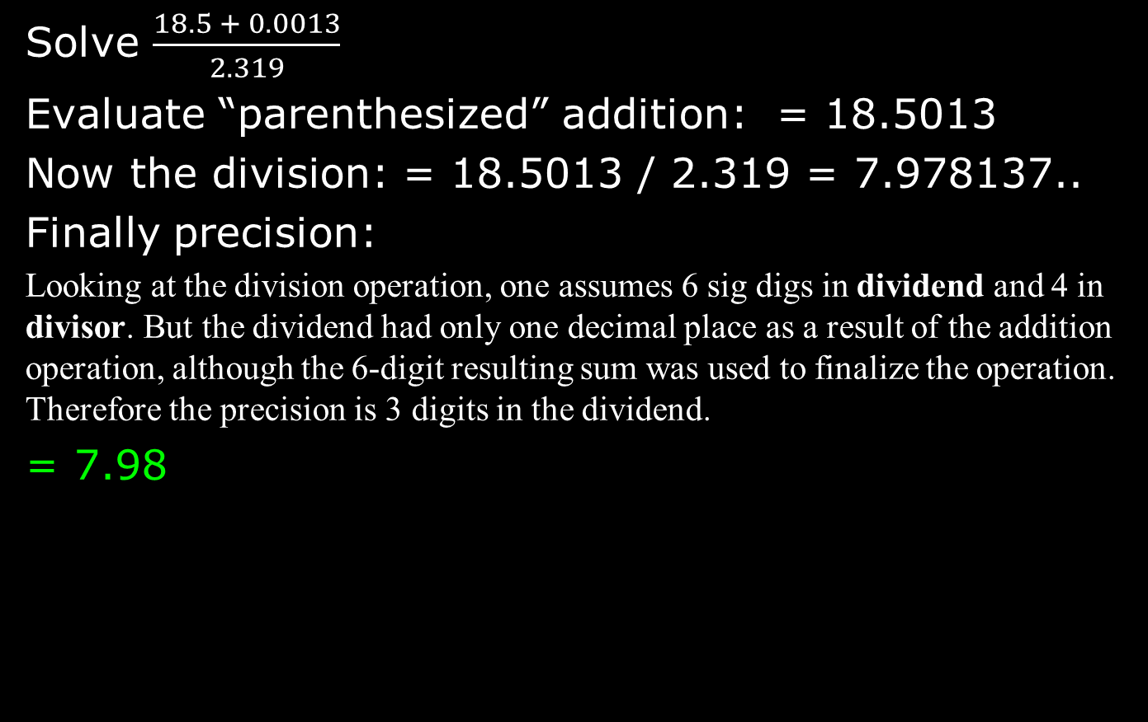
Combined Operations
Solve $\frac{18.5 + 0.0013}{2.319}$
Evaluate “parenthesized” addition: = 18.5013
Now the division: = 18.5013 / 2.319 = 7.978137..
Finally precision:
Looking at the division operation, one assumes 6 sig digs in dividend and 4 in divisor. But the dividend had only one decimal place as a result of the addition operation, although the 6-digit resulting sum was used to finalize the operation. Therefore the precision is 3 digits in the dividend.
= 7.98

Slide 26
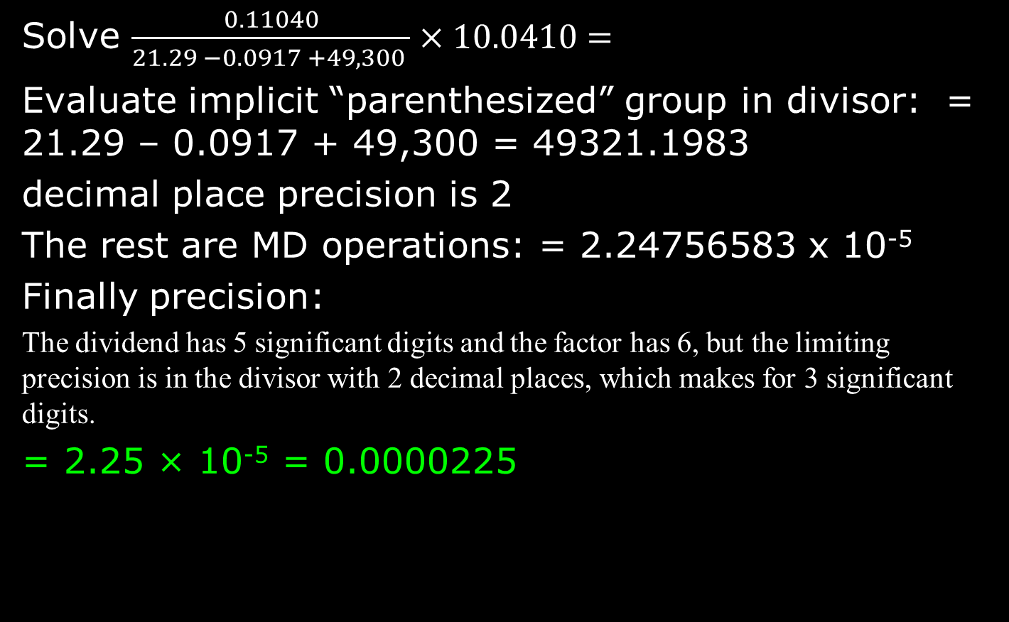
Combined Operations
Solve $\frac{0.11040}{21.29 −0.0917 +49,300 }×10.0410=$
Evaluate implicit “parenthesized” group in divisor: = 21.29 – 0.0917 + 49,300 = 49321.1983
decimal place precision is 2
The rest are MD operations: = 2.24756583 x 10⁻⁵
Finally precision:
The dividend has 5 significant digits and the factor has 6, but the limiting precision is in the divisor with 2 decimal places, which makes for 3 significant digits.
= 2.25 × 10⁻⁵ = 0.0000225

Slide 27
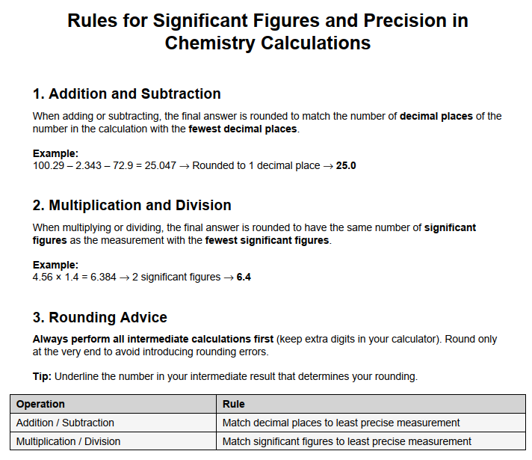
This sheet (also as a PDF in Canvas LMS app) was produced by ChatGPT3.5

Slide 28
Doing Calculations:
NO INTERMEDIATE ROUNDING!!!
Simple example
Calculate the cost of carpeting a 4.8 m x 3.2 m floor where the carpeting costs $42 per square meter
Suppose you do the calculation in steps (intermediate calculations):
The area: 4.8 m × 3.2 m = 15.36 m² (value on calculator display)
Finishing off
  rounding no decimal: 15 m² × ($42 / m²) = $630.00
  rounding to one decimal: 15.4 m² × ($42 / m²) = $646.80
  no rounding: 15.36 m² × ($42 / m²) = $645.12
No need for intermediate result determination in (nearly) all cases:
4.8 m × 3.2 m × ($42 / m²) = $645.12
In business accounting & chemistry, do the rounding at the end of the calculation. To significant digits (or decimal places)

Slide 29
Doing Chem Math
Addition and Subtraction
  look at the DECIMAL PLACES!
Multiplication and Division
  look at the SIGNIFICANT DIGITS!
The Book
Do the Multiplication and Division first
Then do Addition and Subtraction operations
If you do intermediate rounding—I wouldn’t!—then if you follow the book, this is acceptable

Slide 30
PEMDAS
PEMDAS -- (P)arentheses, (E)xponents, (MD) Multiplication/Division, (AS) Addition/Subtraction
5 + 6 x 2 - 8 / 4
  P and E: none
  MD: 5 + 12 - 2
  AS: 15
14² + 633 / 3 - 14 x 8
  P: none
  E: 196 + 633 / 3 - 14 x 8 (did 14²)
  MD: 196 + 211 - 112
  AS: 295

Slide 31
PEMDAS
PEMDAS -- (P)arentheses, (E)xponents, (MD) Multiplication/Division, (AS) Addition/Subtraction
(22.17 + 100.24) x (443.4 + 349.3) / 4³
  P: 122.41 x 792.7 / 4³
  E: 122.41 x 792.7 / 64 (64 is not a MEASUREMENT!)
  MD: 1516.162609
  AS: 1516.162609 ==> 1516

Slide 32
PEMDAS
PEMDAS -- (P)arentheses, (E)xponents, (MD) Multiplication/Division, (AS) Addition/Subtraction
100.13 – 23.433 / ((443.4 + 349.3) / 2⁴)
  P: 100.13 – 23.433 / (792.7 / 2⁴) →
  100.13 – 23.433 / (792.7 / 16) →
  100.13 – 23.433 / 49.54375
  E: evaluated within parentheses!
  MD: 100.13 - 0.47297590513
  AS: 99.6570240949 ==> 99.66

Slide 33
Caution In Using Your Calculator
In your lab, you had the following masses:
You had to get two masses on the balance, then make a calculation to determine the difference to get the mass of a chemical
Your calculator gave a result “4.374”
But rules on precision inform you it is “4.3740”, not “4.374”
So, you need to be aware of precision when your calculator is not
Item | Mass
Empty beaker | 25.4833 g
Beaker with sodium chloride (NaCl) reagent | 29.8573 g
(calculation) Sodium chloride (NaCl) used* | 4.3740 g
* Difference in mass = 29.8573 – 25.4833 = “4.374”

Slide 34
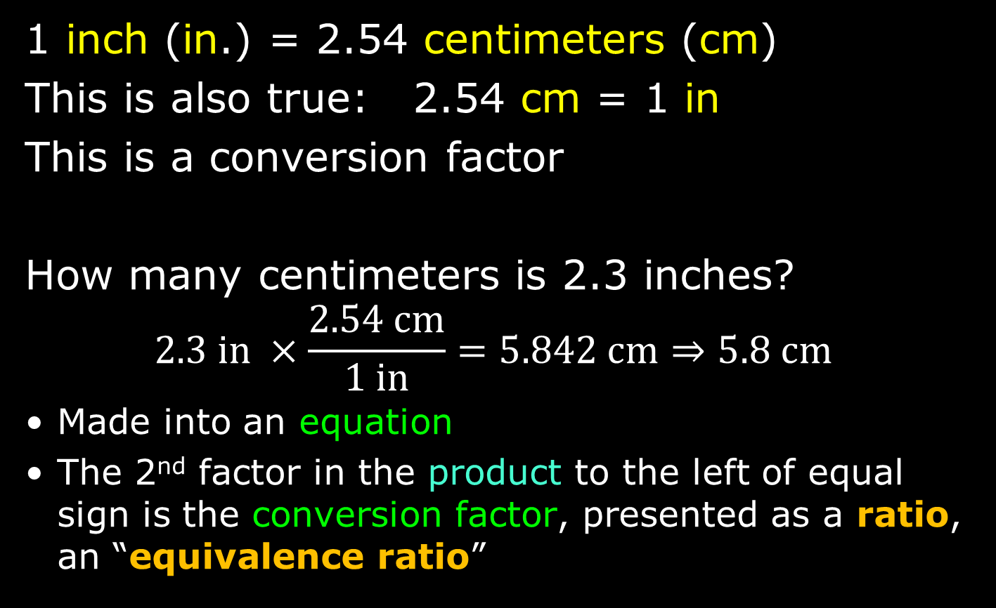
Conversion Factors
1 inch (in.) = 2.54 centimeters (cm)
This is also true: 2.54 cm = 1 in
This is a conversion factor
How many centimeters is 2.3 inches?
$$2.3 in ×\frac{2.54 cm}{1 in}=5.842 cm⇒5.8 cm$$
Made into an equation
The 2nd factor in the product to the left of equal sign is the conversion factor, presented as a ratio, an “equivalence ratio”

Slide 35
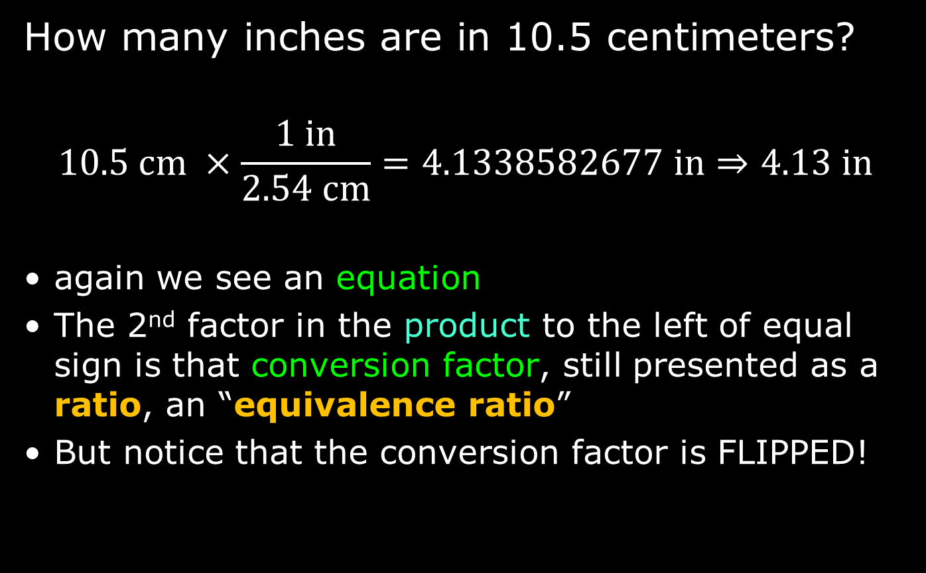
Conversion Factors
How many inches are in 10.5 centimeters?
$$10.5 cm ×\frac{1 in}{2.54 cm}=4.1338582677 in⇒4.13 in$$
again we see an equation
The 2nd factor in the product to the left of equal sign is that conversion factor, still presented as a ratio, an “equivalence ratio”
But notice that the conversion factor is FLIPPED!

Slide 36
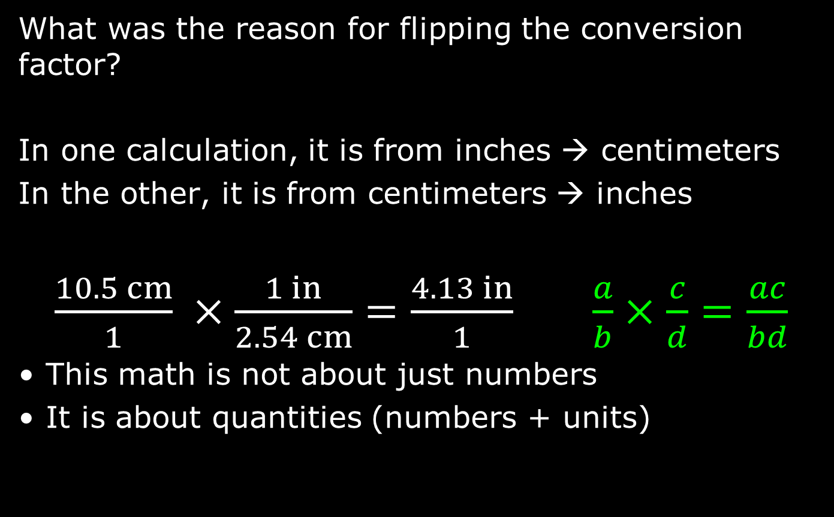
Conversion Factors
What was the reason for flipping the conversion factor?
In one calculation, it is from inches → centimeters
In the other, it is from centimeters → inches
$\frac{10.5 cm}{1} ×\frac{1 in}{2.54 cm}=\frac{4.13 in}{1}$ $\frac{a}{b}×\frac{c}{d}=\frac{ac}{bd}$
This math is not about just numbers
It is about quantities (numbers + units)

Slide 37

Conversion Factors
The equation is presented this way because this shows the process of dealing with quantities and not just numbers in making chemistry calculations
Use of conversion factors classically presents this kind of math, this kind of calculation.
The solution to a problem (as an equation) is set up to get an answer with the correct units, and then calculates the numbers
Keyword in this process: cancellation
$$\frac{10.5 cm}{1} ×\frac{1 in}{2.54 cm}=\frac{4.13 in}{1}$$

Slide 38
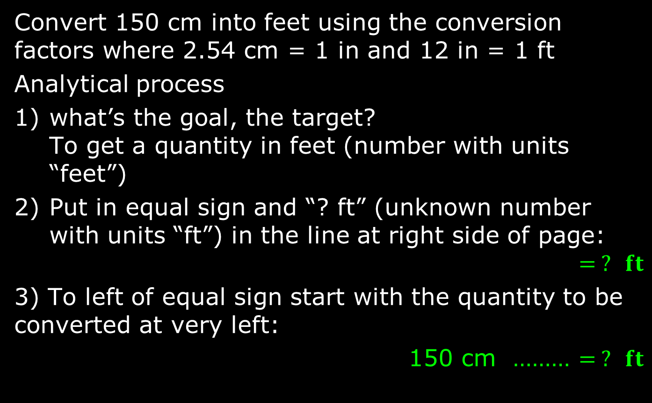
Conversion Factors
Convert 150 cm into feet using the conversion factors where 2.54 cm = 1 in and 12 in = 1 ft
Analytical process
what’s the goal, the target?
To get a quantity in feet (number with units “feet”)
Put in equal sign and “? ft” (unknown number with units “ft”) in the line at right side of page:
$$= ? ft$$
3) To left of equal sign start with the quantity to be converted at very left:
150 cm ……… $= ? ft$

Slide 39
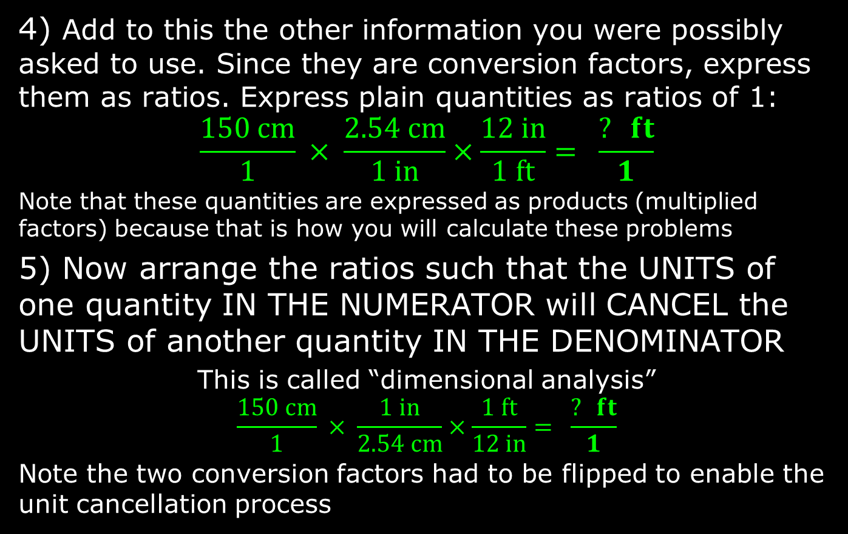
Conversion Factors
4) Add to this the other information you were possibly asked to use. Since they are conversion factors, express them as ratios. Express plain quantities as ratios of 1:
$$\frac{150 cm}{1} × \frac{2.54 cm}{1 in}×\frac{12 in}{1 ft}= \frac{? ft}{1}$$
Note that these quantities are expressed as products (multiplied factors) because that is how you will calculate these problems
5) Now arrange the ratios such that the UNITS of one quantity IN THE NUMERATOR will CANCEL the UNITS of another quantity IN THE DENOMINATOR
This is called “dimensional analysis”
$$\frac{150 cm}{1} × \frac{1 in}{2.54 cm}×\frac{1 ft}{12 in}= \frac{? ft}{1}$$
Note the two conversion factors had to be flipped to enable the unit cancellation process

Slide 40
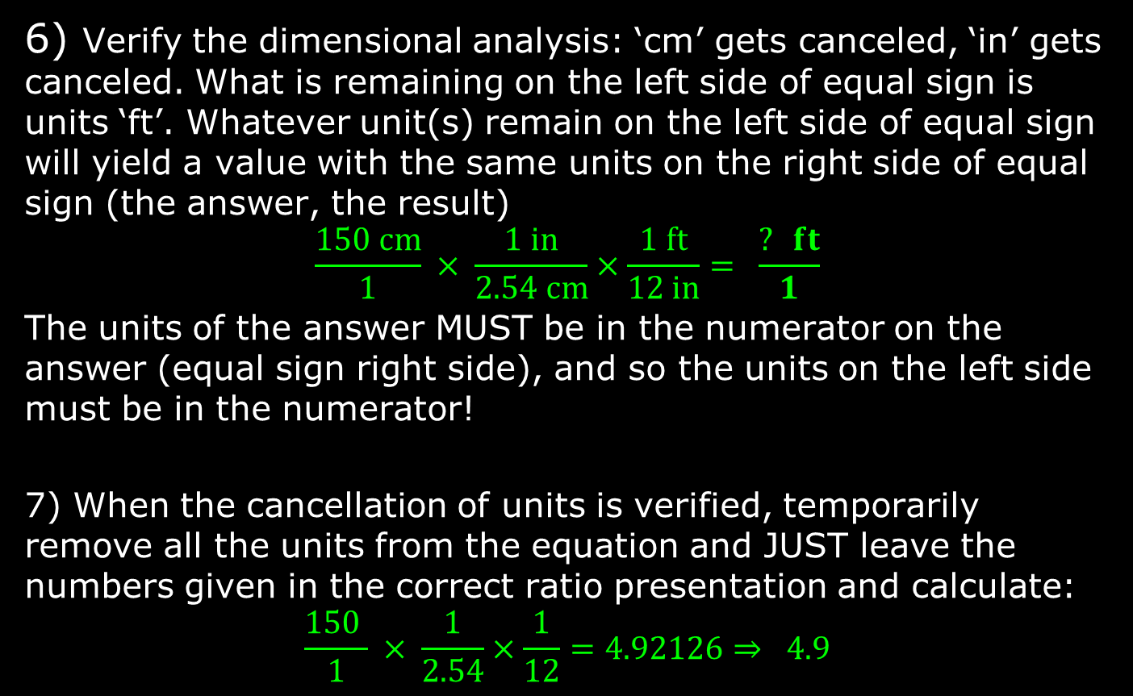
Conversion Factors
6) Verify the dimensional analysis: ‘cm’ gets canceled, ‘in’ gets canceled. What is remaining on the left side of equal sign is units ‘ft’. Whatever unit(s) remain on the left side of equal sign will yield a value with the same units on the right side of equal sign (the answer, the result)
$$\frac{150 cm}{1} × \frac{1 in}{2.54 cm}×\frac{1 ft}{12 in}= \frac{? ft}{1}$$
The units of the answer MUST be in the numerator on the answer (equal sign right side), and so the units on the left side must be in the numerator!
7) When the cancellation of units is verified, temporarily remove all the units from the equation and JUST leave the numbers given in the correct ratio presentation and calculate:
$$\frac{150 }{1} × \frac{1}{2.54}×\frac{1}{12}=4.92126⇒ 4.9$$

Slide 41
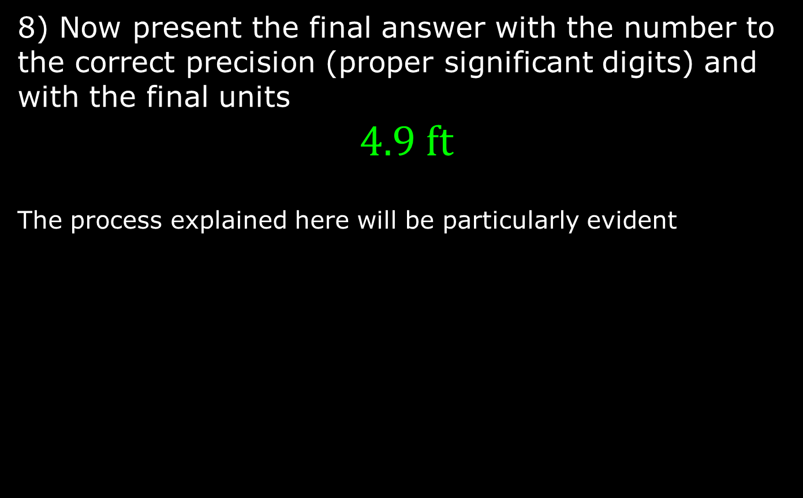
Conversion Factors
8) Now present the final answer with the number to the correct precision (proper significant digits) and with the final units
$$4.9 ft$$
The process explained here will be particularly evident

Slide 42
Typical Conversions
Volume: fluid ounces to milliliter (“fl oz” to “ml”)
Temperature: Celsius to Kelvin (“°C” to “K”)
Pressure: torr to atmosphere (“torr” to “atm”
Conversions not just about measurement systems but also include scales which are powers of 10, by putting prefix names to the units
1 liter (L) = 1000 milliliters = 1000 mL
  not 1000 ml! use SI unit lettering case
1 kilogram (kg) = 1000 grams (g)

Slide 43
Conversion Nomenclature
Prefix | Meaning | Example
Multiple of 10 (greater than 1)
kilo- (k) | 10³ = 1000 | 2 kilograms (kg) = 2000 grams
mega- (M) | 10⁶ = 1,000,000 | 3.7 megajoules (MJ) = 3,700,000 J
giga- (G) | 10⁹ = 1,000,000,000 | 10 gigahertz (GHz) = 10,000,000,000 Hz
Submultiples of 10 (fractions of 1)
deci- (d) | 10⁻¹ = 1/10 | 1 deciliter (dL, dl) = 0.1 L
centi- (c) | 10⁻² = 1/100 | 2.54 centimeter (cm) = 0.0254 m
milli- (m) | 10⁻³ = 1/1000 | 14 millibar (mbar) = 0.014 bar
micro- (u/µ) | 10⁻⁶ = 1/1000000 | 259 microliters (µl, ul, µL, uL) = 0.000259 L
nano- (n) | 10⁻⁹ = 1/1000000000 | 34 nanograms (ng) = 0.000000034 g
pico- (p) | 10⁻¹² = 1/100000000000 | 250 picoliters (pL) = 0.00000000025 L
femto- (f) | 10⁻¹⁵ =1/ 1000000000000000 | 4.3 femtomoles (fmol) = 0.0000000000000043 mol
units in green are often used in chemistry

Slide 44

Density
How much mass is in a given volume
The math definition:
Greek letter rho (ρ) is
symbol for density
Mass has units of gram (g) or kilogram (kg) typically
Volume has units of liters (L), milliliters (mL), cubic centimeters (cm³) typically
Density may be of a SOLID
with units of gram per cubic centimeter (g/cm³)
Density may be of a LIQUID
with units of grams per milliliter (g/mL)
look for this in Experiment 1a lab session
$$density= \frac{mass}{volume}$$
$$ρ=\frac{m}{V}$$

Slide 45
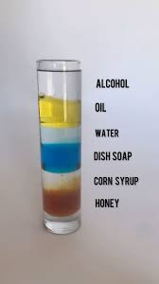
Densities of Natural Substances
Table 1.4.1: Densities of Common Substances
Substance | Density at 25°C (g/cm3)
blood | 1.035
body fat | 0.918
whole milk | 1.030
corn oil | 0.922
mayonnaise | 0.910
honey | 1.420

Slide 46
Problem Solving Process Using Density
The problem/question (from your book)
A mercury thermometer for measuring a patient’s temperature contains 0.750 g of mercury.
What is the volume of this mass of mercury?
The most important thing you will ever do is to spend the time and effort to fully understand the question, and identify the key elements of it
Look for what is asked for: volume of mercury
Look for what is given: a mass (7.50 g) of mercury

Slide 47
Problem Solving Process Using Density
What is missing from the information given in the problem/question?
Usually the information not given are constants of nature and (numerical) properties of matter and energy like atomic weights.
In this case, it is a density.
The density of a substance is a property that allows you to relate its mass to its volume and vice versa
The density of water is 1 g/mL (at 0°C) and is a property of water
The density of mercury is 13.6 g/mL

Slide 48

Problem Solving Process Using Density
For this equation about density, this is all just algebra below which you already know
$ρ=\frac{m}{V}$ ➔ $V×ρ=m$ ➔ $V=\frac{m}{ρ}$ $=$ $\frac{1}{ρ}$ $×m$
In the last manipulation, we have an expression that tells us what the volume is equal to: the inverse of the density multiplied by the mass, or “mass over density”

Slide 49
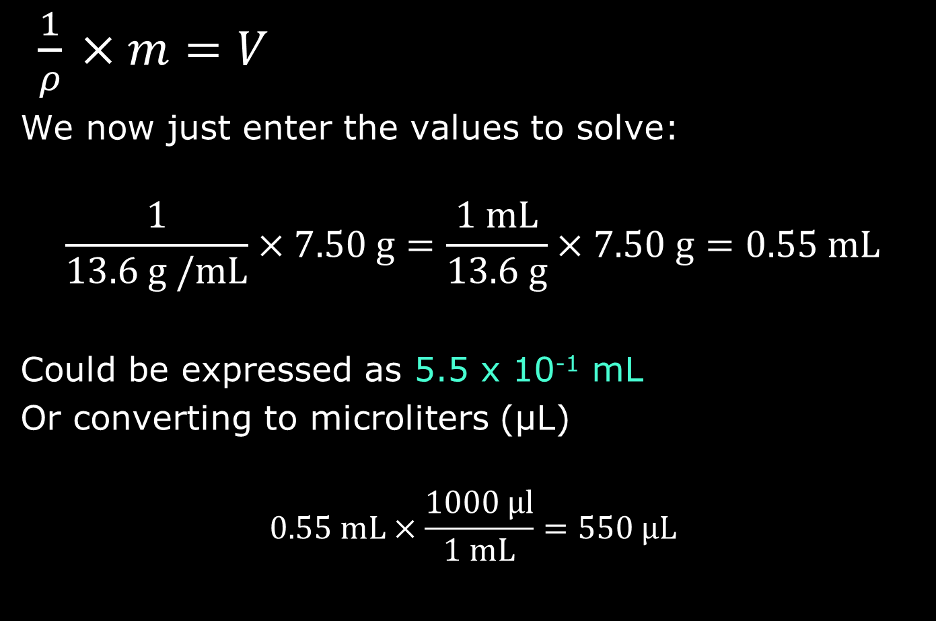
Problem Solving Process Using Density
$\frac{1}{ρ}$ $×m=V$
We now just enter the values to solve:
$$\frac{1}{13.6 \text{g /mL}}×7.50 \text{g}=\frac{1 \text{mL}}{13.6 \text{g}}×7.50 \text{g}=0.55 \text{mL}$$
Could be expressed as 5.5 x 10⁻¹ mL
Or converting to microliters (µL)
$$0.55 \text{mL}×\frac{1000 \text{µl}}{1\text{ mL}}=550 \text{µ}\text{L}$$

Slide 50
Temperature
A measure of the average kinetic energy of particles in a substance
Not energy itself, but an indicator or measure of energy

Slide 51
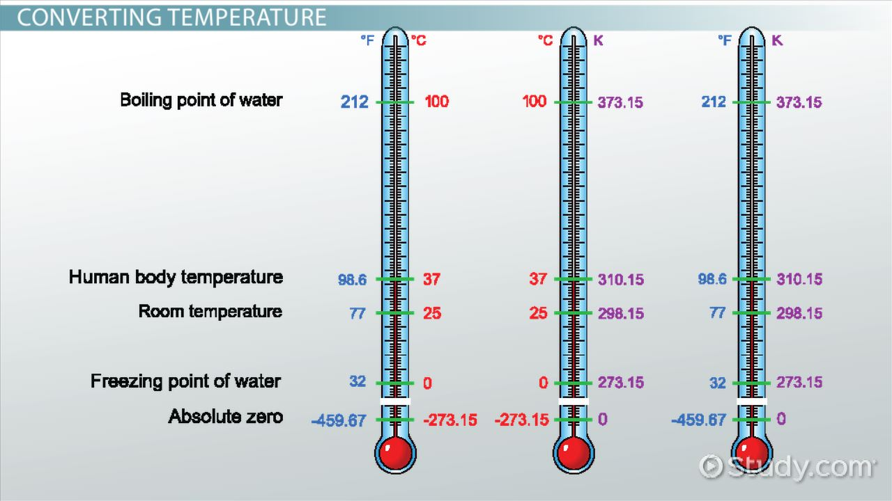
Measuring Temperature
image from Study.com

Slide 52
Temperature Scales
Three scales (measurement types) are used to get a value of temperature
Thermometers usually involve expansion or contraction of calibrated sealed tube of mercury (Hg) or dyed-alcohol
Scale | Water Property
 | freezing point | boiling point
Fahrenheit | 32° F | 212° F
Celsius (centigrade) | 0° C | 100° C
Kelvin | 273 K | 373 K

Slide 53




Converting Temperature
Conversions apply basic algebraic principles of sloped lines
s$\text{lope} =\frac{373 −273}{100 − 0}$ = 1
$$°C =K −273$$
2$73 =1 ×0+\text{intercept}$
Intercept = 273
K$=°C+273$

Slide 54


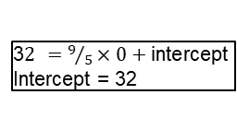

Converting Temperature
Fahrenheit not used in chemistry, but be prepared to convert
s$\text{lope} =\frac{212 −32}{100 − 0}=\frac{180}{100}=\frac{9}{5}$
$$°C =\frac{5}{9}\left(°F −32\right)$$
3$2 =9/5×0+\text{intercept}$
Intercept = 32
°$F =\frac{9}{5}°C+32$

